Slide 1
Bus and Car Delays at Near-Side/Far-Side Stops
Weihua Gu
Department of Electrical Engineering
The Hong Kong Polytechnic University

Slide 2
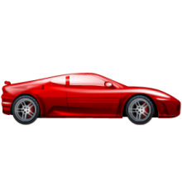
Background
The discharge flow of cars is restrained by bottlenecks created by dwelling buses at a curbside stop.
The bottleneck is more restrictive when it interacts with a nearby signalized intersection (two connected queueing systems).
bottleneck
bus stop
Notes:
Take a look at this near-side stop for example, when a bus dwells in a travel lane shared with cars, the bus can create a bottleneck for cars when they are discharging into the intersection, and will add delays to cars.

Slide 3

Background
Two types of stops:
Near-side
Far-side
bus stop
bus stop

Slide 4
Debate in Literature
Where best to locate a bus stop relative to its nearby intersection?
Near-side is better (e.g., TRB, 1996; Fitzpatrick et al., 1997)
Far-side is better (e.g., Terry and Thomas, 1971)
General and sound analytical models have yet to be formulated for estimating the negative impacts created by these bus stops.

Slide 5
Methodology
Simplified method:
Car queueing at a traffic signal, or at a temporal bottleneck, can be treated as if cars arrive with deterministic headways.
Simplified kinematic wave theory (Lighthill & Whitham, 1955; Richards; 1956; Newell, 1993)
bottleneck
bus stop
Notes:
Take a look at this near-side stop for example, when a bus dwells in a travel lane shared with cars, the bus can create a bottleneck for cars when they are discharging into the intersection, and will add delays to cars.

Slide 6
Methodology
Example of Simplified KWT:
I – inflow
J – jam state
Q – capacity flow
space
car trajectories
red period
green period
time
Q
J
I
time-space diagram
An intersection
approach
Notes:
To develop general analytical models for estimating these car delays, I used a classical traffic flow theory: kinematic wave theory. To see how it works, look at this intersection approach. By using the theory, I developed a diagram that describes the cars’ states in time and space. See these blue car trajectories show that cars are traveling in different states with different speeds or densities. We have an inflow state of cars; then during the red signal, the jammed state propagates backwards; and when the signal turns to green, cars discharge at the capacity state.
Time-space diagram like this is a powerful tool which really helps us to address the problem of interest here.

Slide 7
Methodology
A near-side stop
I – inflow
J – jam state
Q – capacity flow
C – constrained flow state upstream of the dwelling bus
S – starved flow state downstream of the stop
bus trajectory
space
green period
red period
time
Q
S
J
d
J
Q
C
I
Notes:
This added car delays can be modeled using the kinematic wave theory. From the theory, I developed a diagram that describes the cars’ traffic states in time and space, for a bus stop located a distance d upstream of the signal.
See the yellow region indicates that cars approach the intersection in the free-flowing, inflow state, denoted by “I”. And a jam state propagates backward during the red period. Now a bus approaches the stop; see the dark bold line that indicates its trajectory. The bus gets stuck in the car queue, and reaches the stop when the car queue clears. It loads the passengers, closes the door, and is ready for departure.
Before the bus arrives at the stop, cars will discharge in the capacity flow. But after that, cars will form a slow-moving queue behind the bus, and discharge at a constrained flow. Those cars that fail to discharge during the green period will join the jammed queue, making this queue bigger, and the queue will hold the bus off for a while before it can depart.

Slide 8
Methodology
We assume:
Bus arrivals are random (uniformly distributed in time).
Large bus headways so that each dwelling bus can be treated independently.
Bus dwell time follows a given distribution, e.g., a uniform distribution in [S_{min}, S_{max}].
We then find the expected extra car delays and bus delays created by a dwelling bus by taking expectations with respect to bus arrival times and dwell times.
Notes:
Now we assume that both bus arrivals and dwell times are random, and that bus arrivals are treated independently due to sufficiently large bus headways.
Then we construct the time-space diagrams for a large range of operating conditions, and then take the expectations of the extra car delays and the bus delays with respect to random bus arrivals and dwell times.

Slide 9
Numerical Results
Comparing near- and far-side stops: expected car delays
Notes:
And here are some results. In this diagram I compare the expected extra car delays for the near-side and far-side stops. These delays are plotted as functions of the distance between the stop and the intersection, d. We see in this case that a near-side stop always produces lower car delays than its far-side counterpart.
Also note that the two curves are both decreasing as d increases, meaning that it’s better to place the stop away from the intersection.

Slide 10
Numerical Results
Comparing near- and far-side stops: expected bus delays
Notes:
And here are some results. In this diagram I compare the expected extra car delays for the near-side and far-side stops. These delays are plotted as functions of the distance between the stop and the intersection, d. We see in this case that a near-side stop always produces lower car delays than its far-side counterpart.
Also note that the two curves are both decreasing as d increases, meaning that it’s better to place the stop away from the intersection.

Slide 11
Numerical Results
Comparing near- and far-side stops: expected traveler delays
Notes:
And here are some results. In this diagram I compare the expected extra car delays for the near-side and far-side stops. These delays are plotted as functions of the distance between the stop and the intersection, d. We see in this case that a near-side stop always produces lower car delays than its far-side counterpart.
Also note that the two curves are both decreasing as d increases, meaning that it’s better to place the stop away from the intersection.

Slide 12
Mitigation Strategies
Bus holding
bus departure not delayed
space
red period
green period
time
intersection
bus stop
J
J
Q
Q
I
bus trajectory
without holding
Bus dwell times
bus holding time
bus trajectory
with holding
Notes:
Now if we can accurately predict bus arrival times using onboard GPS, we can defer select bus arrivals to reduce the negative impacts on cars at near-side stops. And this is how it works. Look at the dashed, red bus trajectory. We see that the dwelling bus will block the discharging car flow during the green signal. Also note that although the bus finishes serving passengers at this moment, it is stuck in the car queue, and has to wait until this moment to depart the stop.
Now we postpone the arrival of this bus by this amount of time, so that it will block much less green time, but can still clear the intersection at the same time as if it were not held. So the car delays can be saved without delaying buses in the longer run.
This is just for illustration. In reality we don’t need to know the bus service time since it’s usually hard to predict. We only need know the range of bus service time distribution, i.e. the min and max of service time, then we can apply this holding strategy.

Slide 13
Mitigation Strategies
Benefit of holding
Notes:
In the same diagram I plot the reduced extra car delay when applying the holding strategy; see the green curve. Note that the holding strategy can significantly reduce car delays, especially when d is small. With the strategy, now we can place the stops much closer to the intersection without adding delays to cars. This is useful because a stop near intersection will facilitate passengers’ access.

Slide 14
Mitigation Strategies
Benefit of holding
Notes:
In the same diagram I plot the reduced extra car delay when applying the holding strategy; see the green curve. Note that the holding strategy can significantly reduce car delays, especially when d is small. With the strategy, now we can place the stops much closer to the intersection without adding delays to cars. This is useful because a stop near intersection will facilitate passengers’ access.

Slide 15
Mitigation Strategies
Dynamic Signal Control
space
time
intersection
bus stop
J
J
Q
Q
I
Original bus trajectory
Bus dwell times
Notes:
And we can do even better. This is an example of my ongoing research. The basic idea is to shift signal phases instead of shifting bus arrivals.
For the same example,

Slide 16
Mitigation Strategies
Dynamic Signal Control
Bus delay also saved!
space
time
intersection
bus stop
J
Q
J
Q
I
Original bus trajectory
New bus trajectory
Bus dwell times
Notes:
Now we shorten both the red and green periods of the first cycle, and increase those periods in the second cycle, so that the green ratio remains the same. See how this new bus trajectory actually does not block any green signal. And that not only car delays, but also the bus delay have been saved! Another good news is this strategy can be applied to both near- and far-side stops.
I’m expecting to have the results of this strategy in the near future.

Slide 17
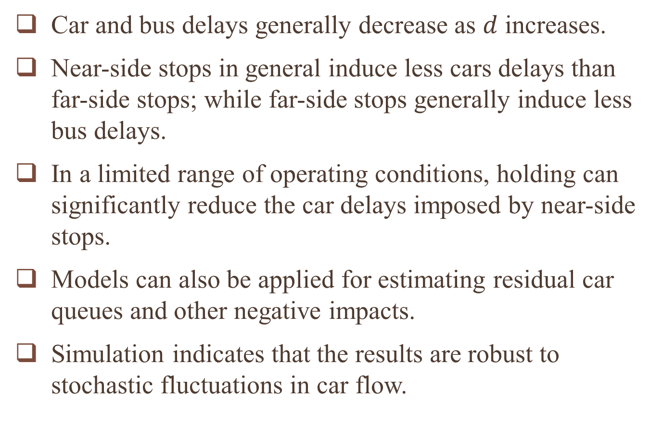
Concluding Remarks
Car and bus delays generally decrease as $d$ increases.
Near-side stops in general induce less cars delays than far-side stops; while far-side stops generally induce less bus delays.
In a limited range of operating conditions, holding can significantly reduce the car delays imposed by near-side stops.
Models can also be applied for estimating residual car queues and other negative impacts.
Simulation indicates that the results are robust to stochastic fluctuations in car flow.
Notes:
Okay, let me briefly summarized the presentation. I studied serial queueing systems which are widely applied in the transportation field. I developed analytical models using Markov renewal processes, and of coz the methodology can be used for other queueing systems of this type. Results from my models have many practical implications on design, operation, and control of tandem bus stops and toll stations, and potentially other transportation systems.

